Slide 1



CINEA/EMFAF/2021/3.1.2/03/SC04/SI2.881222
Specific Contract 2021/3.1.2/03/SC04
Hosting, maintenance and further development of the Regional Database for the Mediterranean and Black Seas
Statistical Workshop
Estimation of fleet and stock related variables in the Greek fisheries under Regulation (EC) No 2017/1004
January 2025
HCMR, FRI teams

Slide 2
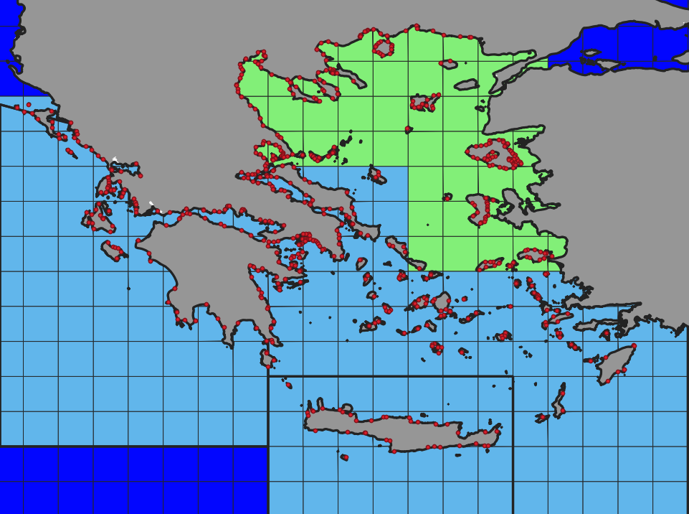


Introduction
Greece
Three GSAs,
Two Institutes,
A large and scattered fleet,
More than 1,500,000 days at
sea effort (2023).
GSA 22
GSA 20
GSA 23

Slide 3
Introduction
Greece – data availability
Effort
Vessels > 12 m
VMS data,
Effort is estimated at various levels of the spatial and temporal scale.
Vessels < 12 m
Effort-Landings survey (DCF).
Spatially and technically stratified random sampling scheme.
Raising to the total fleet (National Fleet Registry), taking into account fleet activity - inactivity.
Estimations per metier, GSA, Vessel Length category, Quarter.
Effort metrics: days at sea, days at sea x Power, days at sea x Tonnage

Slide 4
Introduction
Greece – data availability
Landings
Vessels >12 m
ERS data (since 2016),
Census, information for landings weight and value, per species, metier, statistical rectangle, trip, vessel → aggregation to the level defined by DCF
Vessels <12 m
Effort-Landings survey (DCF).
Raising to the total effort.
Estimations per species, metier, Vessel Length category , GSA, Quarter.

Slide 5
Estimations based on Biological sampling
Discards
Target: Estimation of discard ratio and total discards for the preferred aggregation level (GSA, Vessel length category, Gear, quarter, Species)
Discards are considered as the portion of the total catch thrown back into the sea.
Estimation based on on-board sampling.

Slide 6
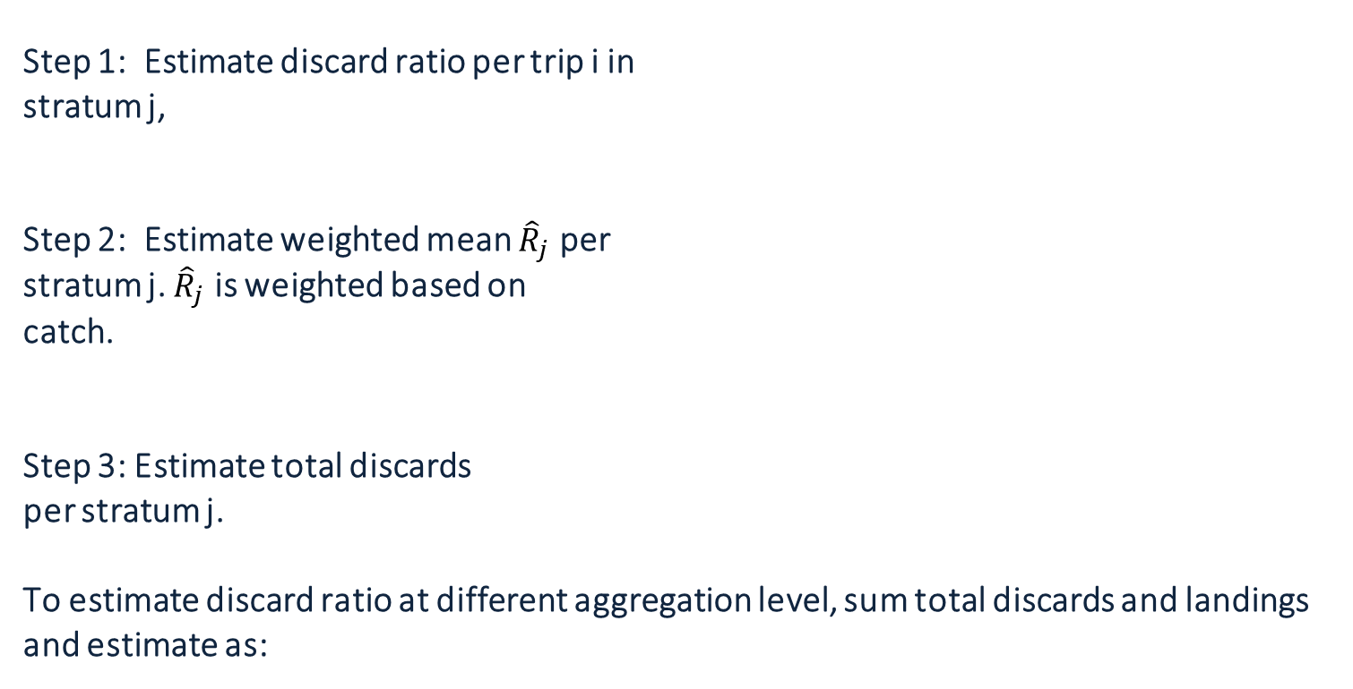
Discards for the multi-gear small scale Greek fisheries
Discards
Step 1: Estimate discard ratio per trip i in
stratum j,
Step 2: Estimate weighted mean ${\hat{R}}_{j}$ per
stratum j. ${\hat{R}}_{j}$ is weighted based on
catch.
Step 3: Estimate total discards
per stratum j.
To estimate discard ratio at different aggregation level, sum total discards and landings and estimate as:
,

Slide 7
Demographics for the multi-gear small scale Greek fisheries
Lengths
Target: Raising taxa lengths, collected based on “biological data sampling scheme”, to the stratified total landings and discards.
Species lengths: TL for fish, ML for cephalopods, CL for crustaceans, LJL for swordfish, UJL for tunas. Lengths are “floored” to the nearest cm (fish, cephalopods) or mm (crustaceans).
Stratified total landings - discards: GSA →Vessel length (vl)→Fishing Gear -Metier (fg) → Catch category (cc) → Quarter (q) → Taxon (t)
Biological raw data: length measurements per Taxon (t), Haul (H), Fishing Gear -Metier (fg) , Trip, Vessel length (vl), GSA
Haul data: subsample weight (sw), total weight (tw), at least 10% for discards (or at least one box)

Slide 8




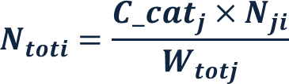

Demographics for the multi-gear small scale Greek fisheries
Lengths – process 1
Step 1: Sum $n$ per length class i,
Step 2: Raise $N_{i}$ to total weight per taxon,
haul, catch category, using sample weight,
Step 3: Sum $N_{hi}$ per trip,
Step 4: Sum $N_{Ti}$, $tw$ per stratum j*
Step 5: Raise $N_{ji}$ to total Catch category
per stratum j
,
Strata: GSA* →Vessel length (vl)→Fishing Gear -Metier (fg) → Catch category (cc) → Quarter (q) → Taxon (t)

Slide 9
Demographics for the multi-gear small scale Greek fisheries
Lengths – process 2
Step 1: Set an appropriate length class l_cl (depending on the species and data call requirements e.g. 2 mm) and calculate number of length classes N_classes and all median length classes med-l_cli:
Step 2: Calculate the median length classes i:
Step 3: Calculate the number of individuals measured in each length class:
Step 4: Calculate weight at given length class I (where a, b are the coefficients of the length weight relationship W = a*Lb):
Step 5: Calculate total weight of each length class i:
Step 6: Sum weights over all length classes in aggregation p:
Step 7: Calculate the percentage contribution of each length class weight in summed total weights:
Step 8: Calculate the biomass at each length class i (multiply percentage contribution of each length class to total by total landings weight for each length class - from landings table):
Step 9: Calculate number of individuals landed per length class i:
Step 10: Generate the final output by assigning the number of individuals landed (Ni) to each corresponding length class (medi):
Length classes | Nb of individuals
med_{i} | N_{i}
med_{i+1} | N_{i+1}
… | …
med_{n} | N_{n}

Slide 10

Demographics for the multi-gear small scale Greek fisheries
Lengths – process selection criterion / Data quality
Estimated W$sample$ / Measured W$sample$ → ±10% ➔ process 1, otherwise process 2
Estimated W$sample$ / Measured W$sample$ → ±50% ➔ process 1, otherwise process 2
Protocol, sampling design
Sampling
Protocol-DB comparison
Data quality checks throughout all levels of the process
DataBase
DB design to prevent errors
Many data quality tests on DB export
Measures of dispersion
Analysis
Dq checks, visual inspection
Qualitrain tools
Final outcome
“Data quality” feedback
“Data correction” loops

Slide 11
Biological Data
ALK
Step 1: Calculate the number of records (Nb of individuals with age i by length bin j):
Step 2: Sum the number of records in each row (Nb of individuals with age i over all ages in each length bin j):
Step 3: Calculate the proportion of each age to each length bin:
where in the following table we have:
(i, j) | Age_{i} | Age_{i+1} | Age_{i+2} | … | Age_{N} | Totals
Lenght_{j} | p_{i,j} |  | … | … | p_{i,N}
Lenght_{j+1} |  | p_{i+1.j+1} | … | … | …
… |  |  | … | … | …
Lenght_{K} |  |  | … | … | p_{K,N}
Totals
The table can be used in the construction of the Age frequency distribution (in Demographics)

Slide 12
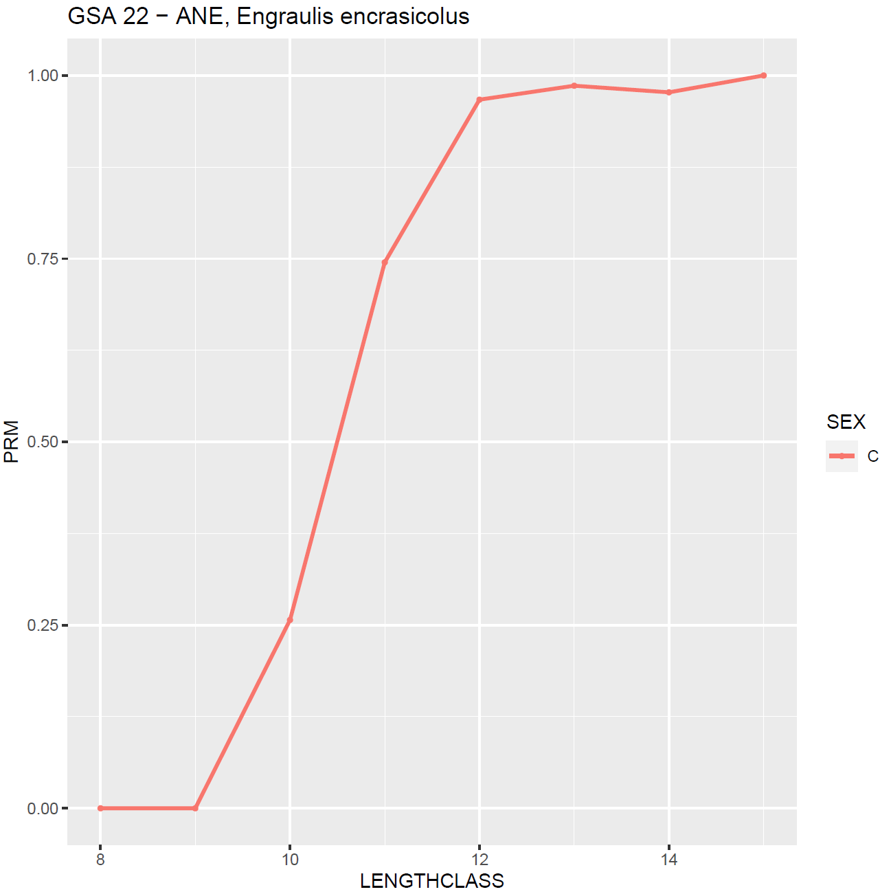
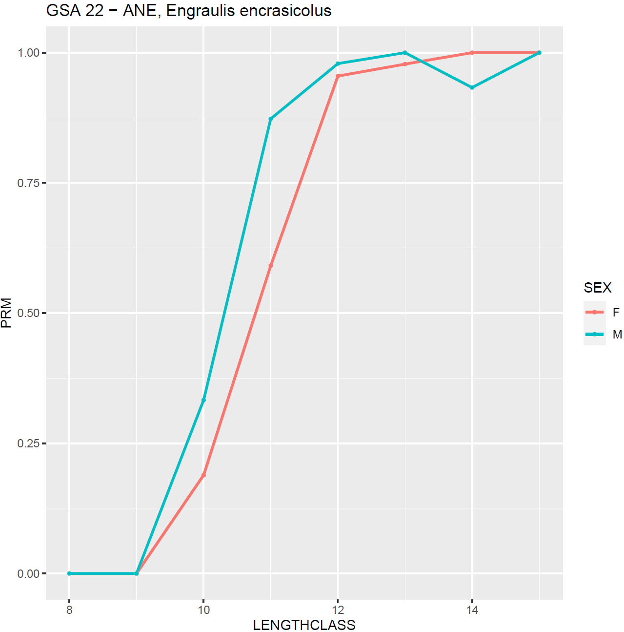
Biological Data
Maturity
Macroscopically (and microscopically when necessary) maturity estimation by stock (species + GSA),
Maturity scale → mature, immature (reproductively active or not),
Estimation of mature/all ratio per length class (and sex),
Data quality estimation: Generalised linear models (binomial) for estimating the maturity ogive. Nagelkerke's R squared estimator to evaluate goodness of fit. Visual inspection to detect outliers.

Slide 13

CINEA/EMFAF/2021/3.1.2/03/SC04/SI2.881222
Specific Contract 2021/3.1.2/03/SC04
Hosting, maintenance and further development of the Regional Database for the Mediterranean and Black Seas
We thank you for your attention
https://rdbfis.eu/

